Slide 1

Telecom Customer Churn

Slide 2
About me
Background ? (B-tech or M-tech)
B.Sc IT
Why you want to learn Data Science ?
To upskill for career growth
Any work experience ?
Worked as an IT Recruiter for around 3 years

Slide 3
Agenda
To solve Telecom Customer Churn problem
Exploratory Data Analysis:
Data Cleaning Steps
Data Manipulation Steps
Visualization

Slide 4
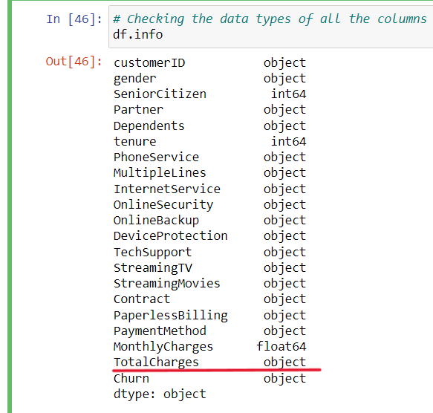
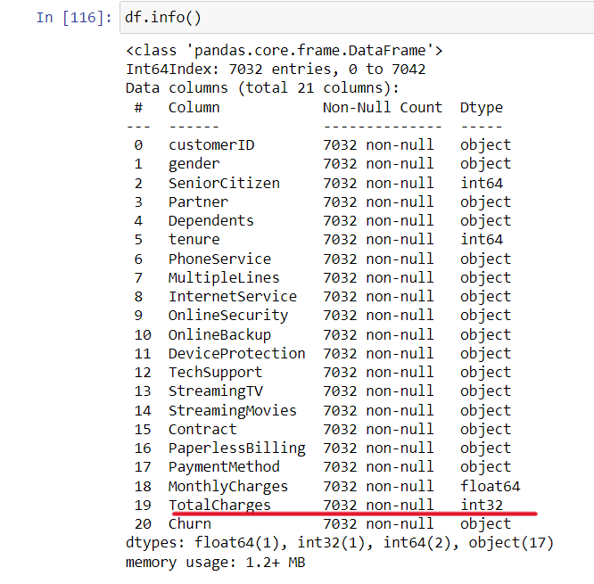
Data Cleaning and Manipulation

Slide 5
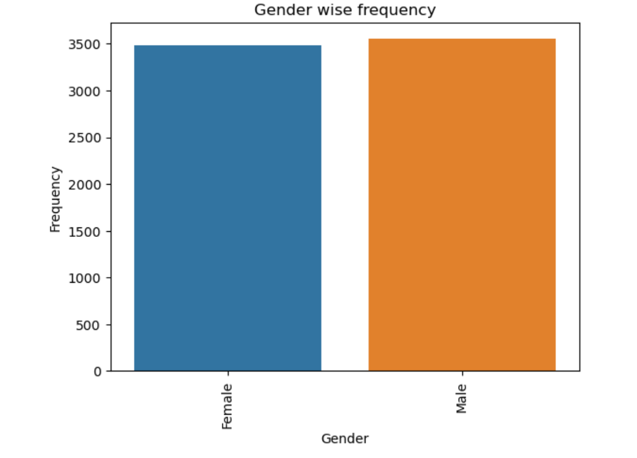
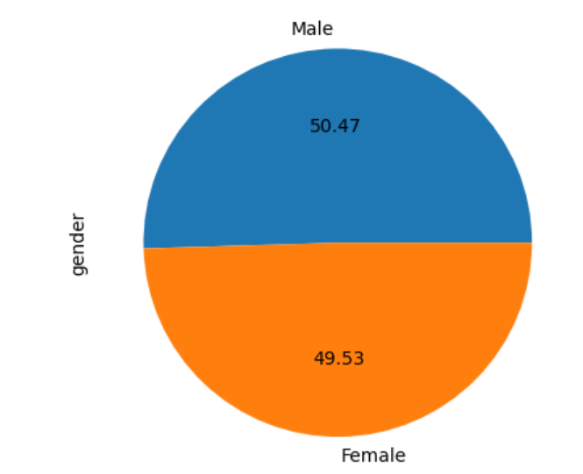
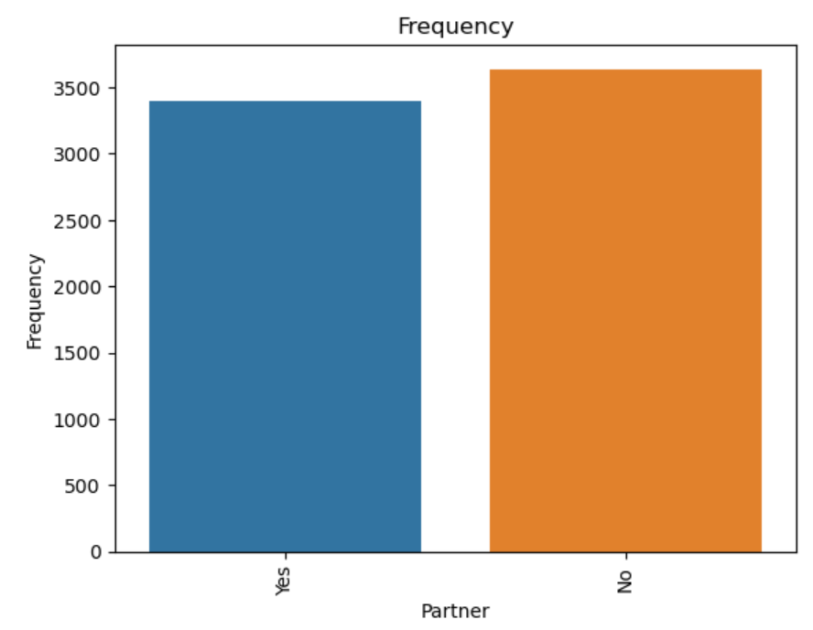
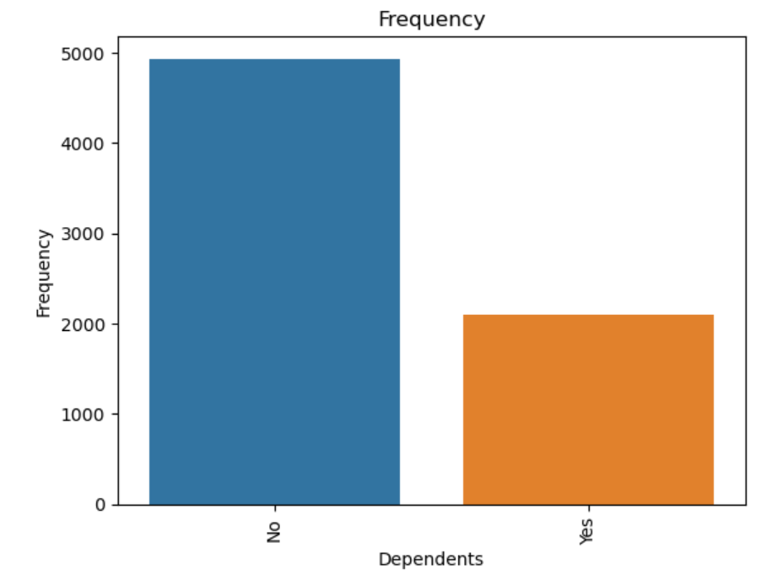
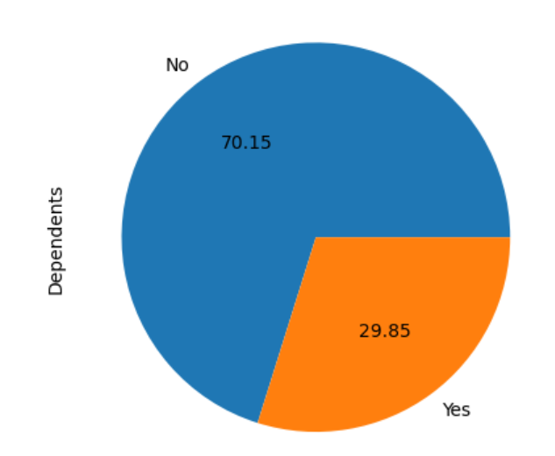
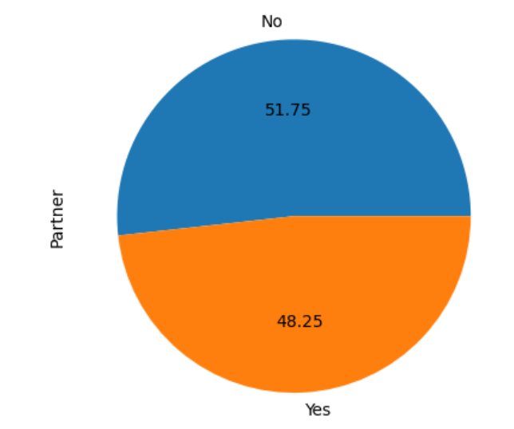
Demographics

Slide 6
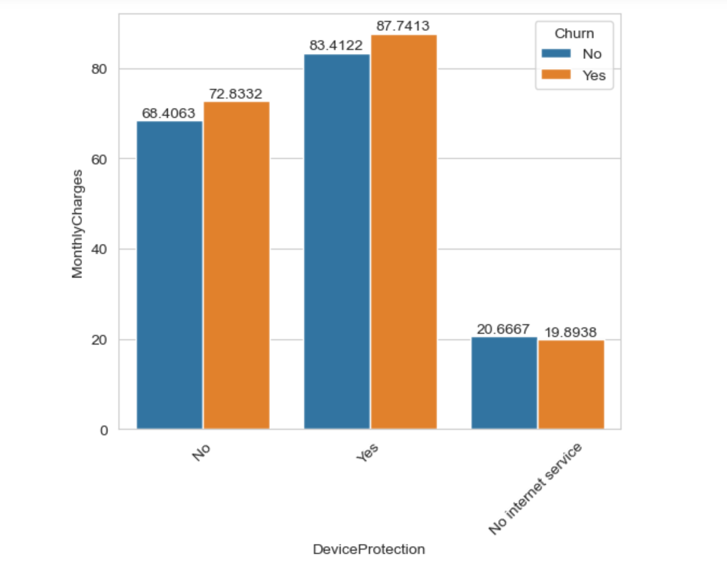
Device protection
Customers are churning because
of Unsatisfactory Device
protection service

Slide 7
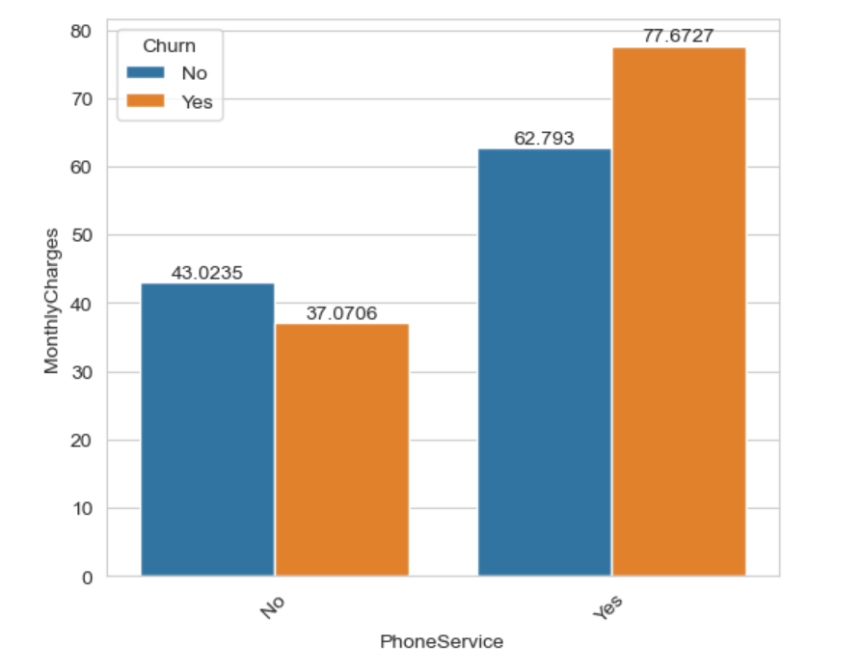
Phone Service
Customers are churning
because of poor network
coverage

Slide 8
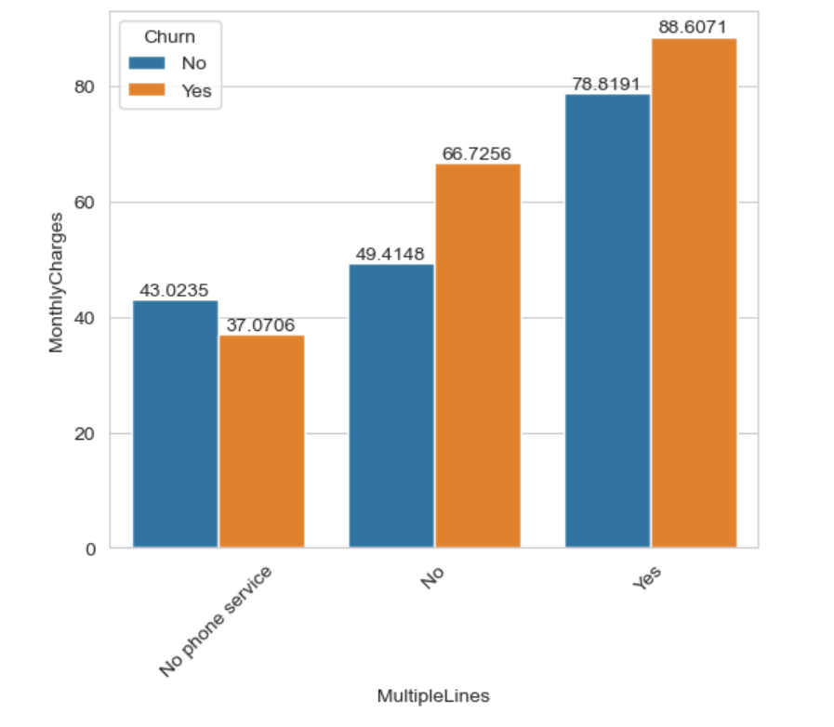
Multiple Lines
Customers having Multiple lines
are churning more for monthly
charges

Slide 9
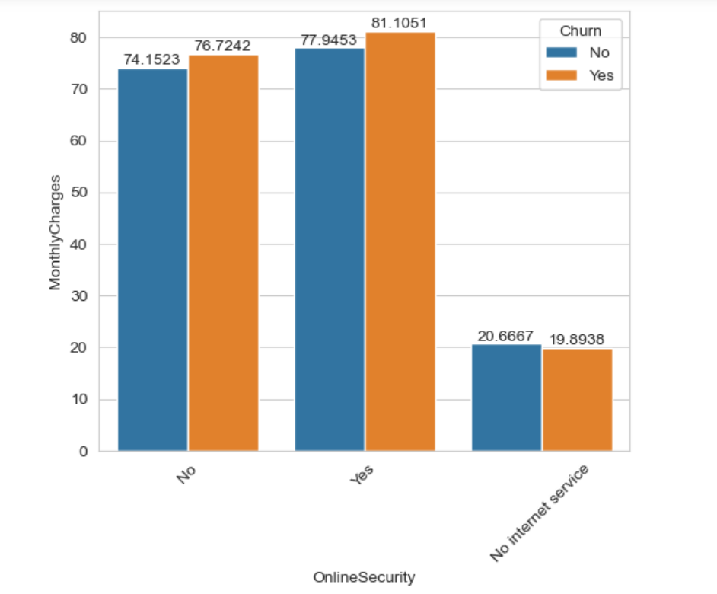
Online Security
Some part of customers are
churning because of
online security

Slide 10
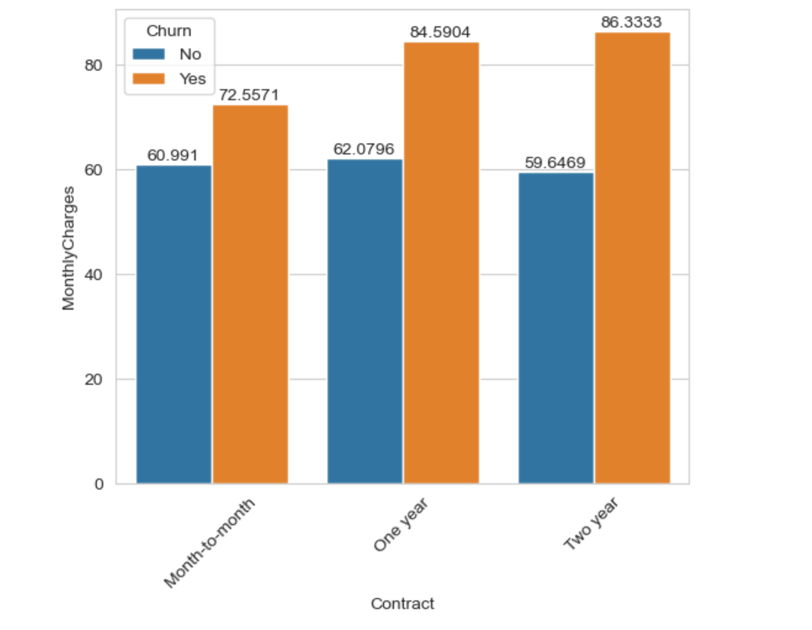
Contract
Customers in contract are
churning because of monthly
charges

Slide 11
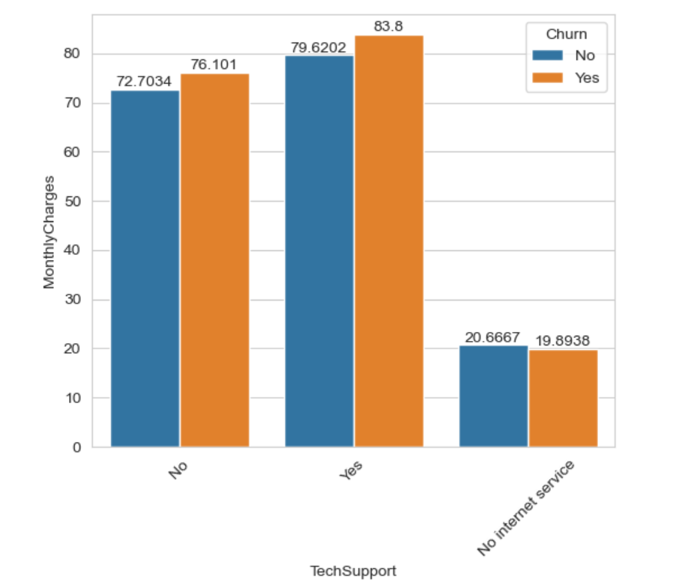
Tech Support
Customers are churning because
of poor Tech support

Slide 12
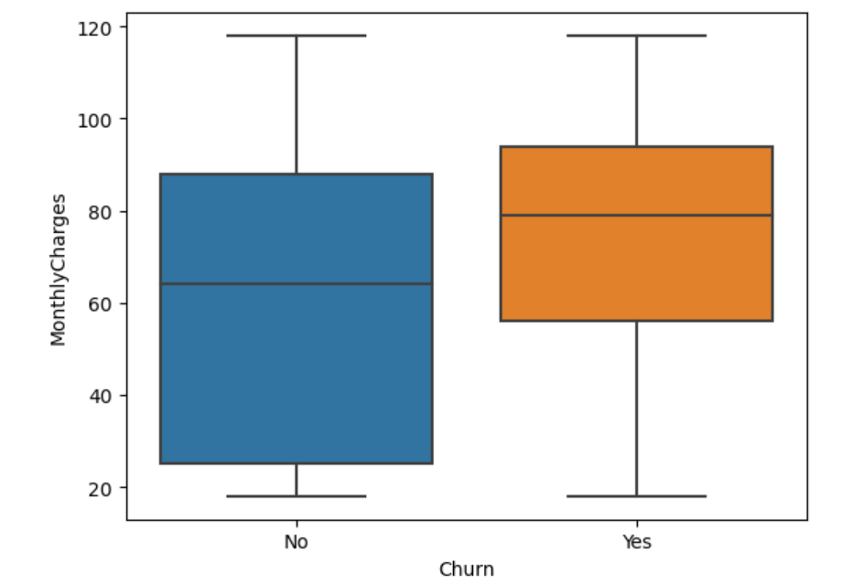
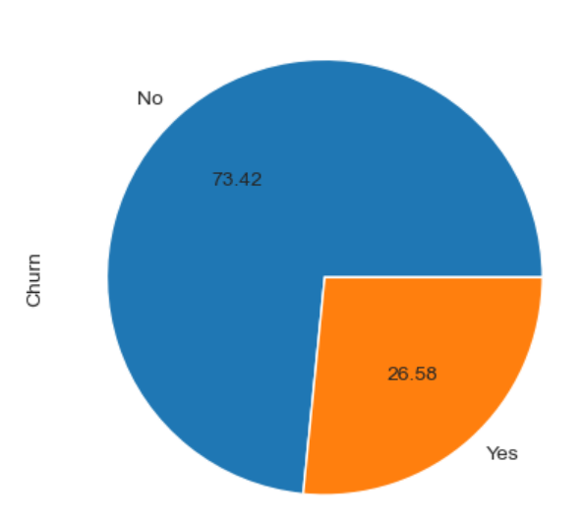
Churn Rate
Customers who are paying
between $ 60 - $ 80 / month
are churning more
because of expensive
monthly charges

Slide 13
Business Problem
This Telecom company should work on reducing monthly charges to
retain its customers and also focus on various services they offer.
- Tech Support
- Device Protection
- Phone Service
- Online Security

Slide 14
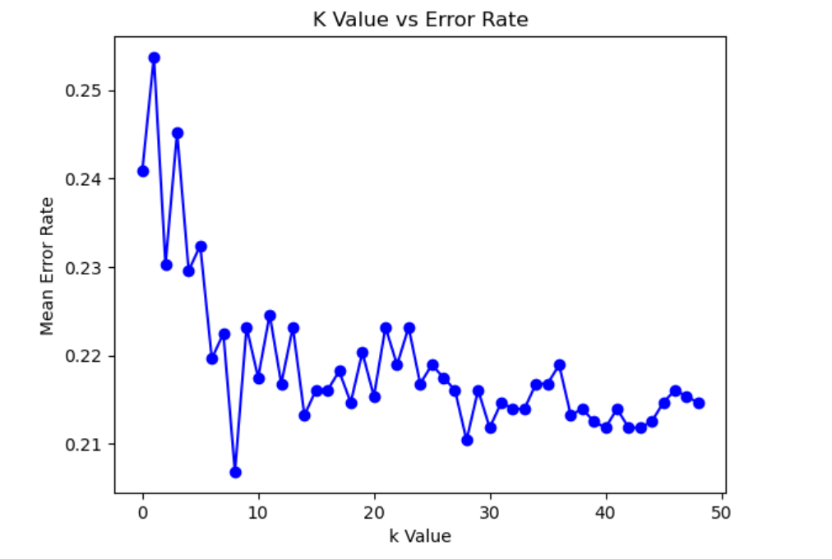
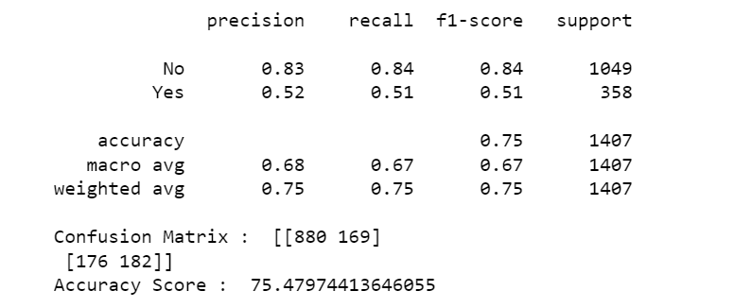
KNN Classifier

Slide 15
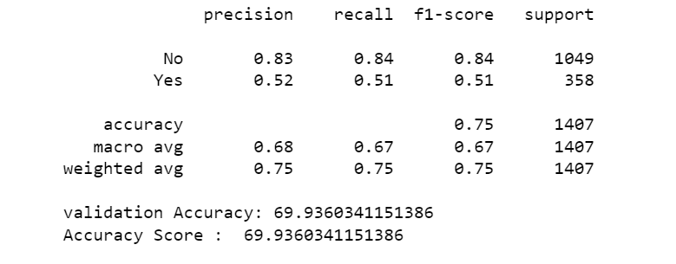
Naive Bayes

Slide 16
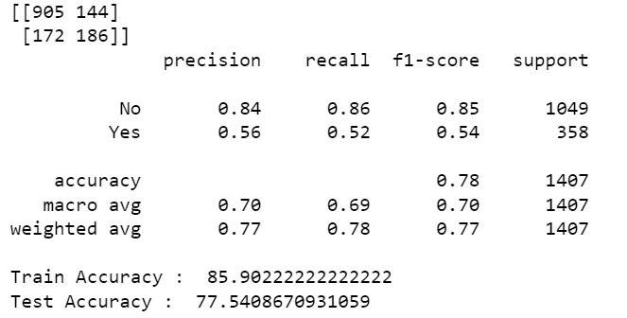
Support Vector Machines

Slide 17
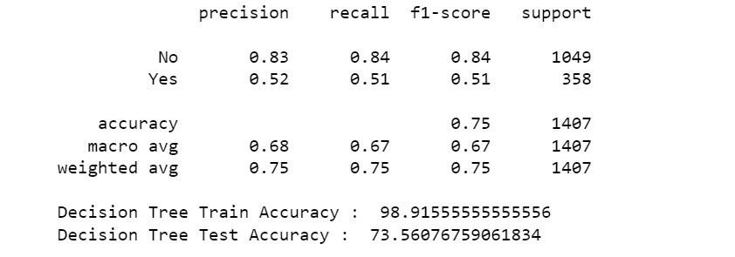
Decision Tree

Slide 18
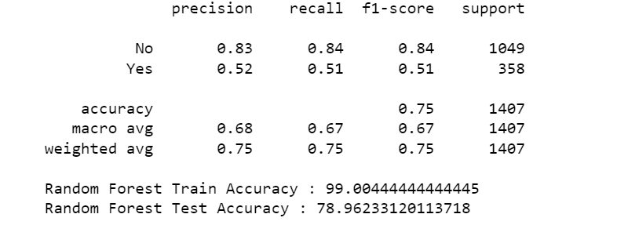
Random Forest Classifier

Slide 19

THANK YOU

